Slide 1
OS Project System Health
Done BY :
1-Gasser Amr Eldabaa

Slide 2

System Reporting Made Easy: A Bash Script Solution
This presentation explores a Bash script-based solution for generating detailed system reports. Designed for ease of use and flexibility, this project offers comprehensive insights into system performance.

Slide 3
Overview: Comprehensive System Metrics at Your Fingertips
CPU, Disk, Memory, Network, GPU, and System Load
Detailed Reports for Enhanced Understanding
Our solution provides a comprehensive overview of key system metrics, covering CPU utilization, disk usage, memory consumption, network traffic, GPU performance, and overall system load.
These metrics are presented in clear, concise, and visually appealing HTML reports, making it easy to interpret system performance and identify potential issues.

Slide 4
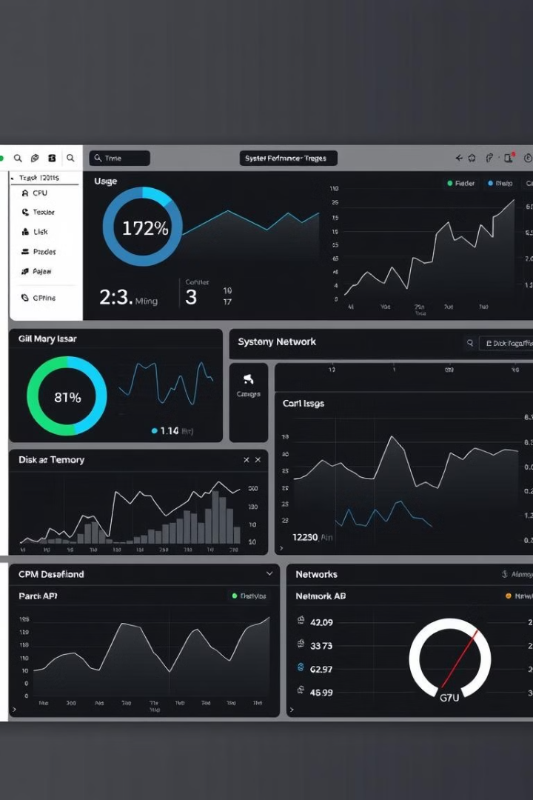
Supported Metrics: CPU, Disk, Memory, Network, GPU, and System Load
1
CPU Utilization
2
Disk Space Usage
Track CPU usage across cores, identify bottlenecks, and optimize performance.
Monitor disk space consumption, identify potential storage issues, and plan for future needs.
3
Memory Consumption
4
Network Traffic
Monitor network activity, identify bandwidth usage trends, and diagnose potential network issues.
Analyze memory usage patterns, identify potential leaks, and optimize memory allocation.

Slide 5
Seamless Reporting: Styled HTML Files for Enhanced Readability
Organized and Informative Reports
Responsive Design for Cross-Platform Viewing
The reports are presented in a clear and organized manner, making it easy to understand the information and quickly identify key insights.
The HTML files are designed to be responsive, ensuring they look great on different devices, including desktops, laptops, tablets, and smartphones.

Slide 6

Graphical User Interface: Zenity for a Streamlined Experience
Easy Configuration
Intuitive Interaction
Simplified Workflow
Users can easily configure reporting options, such as the metrics to include, the report format, and the output location.
Zenity provides a user-friendly interface, making it easy for users to navigate and interact with the script.
The graphical interface streamlines the report generation process, making it more efficient and user-friendly.

Slide 7
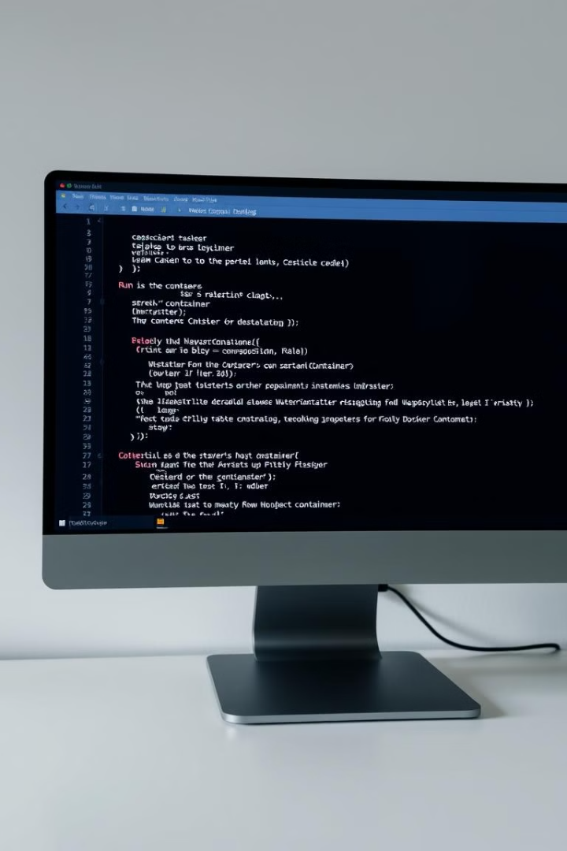


Deployment Flexibility: Run on the Host or in a Docker Container
Host Execution
Docker Containerization
The script can be executed directly on the host machine, providing a seamless integration with existing system infrastructure.
The script can also be packaged within a Docker container, allowing for portable deployment across different environments.

Slide 8

Key System Metrics: Visualized with Responsive HTML and CSS
Data Visualization
System metrics are visualized using responsive HTML and CSS, creating interactive and informative reports.
1
2
Interactive Charts and Graphs
Users can easily navigate and interact with charts and graphs, gaining deeper insights into system performance.

Slide 9



Suitable for Standalone and Containerized Environments
Standalone Deployment
The script is suitable for standalone environments, where it can be easily integrated into existing monitoring workflows.
Containerized Deployment
The containerized version of the script enables flexible deployment across different environments, including cloud platforms.

Slide 10



Project Benefits: Improved Monitoring, Troubleshooting, and Optimization
Enhanced Monitoring
1
Provides real-time insights into system performance, enabling proactive monitoring and early detection of issues.
Simplified Troubleshooting
2
Detailed system reports aid in identifying and resolving performance issues, minimizing downtime.
Optimized Performance
3
In-depth analysis of system metrics allows for effective performance optimization, maximizing resource utilization.

Slide 11

Conclusion: The Power of Bash Scripting for System Reporting
1
2
Efficiency
Flexibility
This Bash script solution offers a highly efficient and effective way to generate system reports.
It can be adapted to different environments and reporting needs, providing valuable insights across various use cases.

